Slide 1
6.6
Multidimentional Feynman-Kac Theorem
指導老師：戴天時教授
學 生：施嘉紋

Slide 2

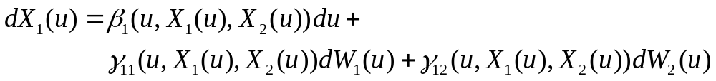
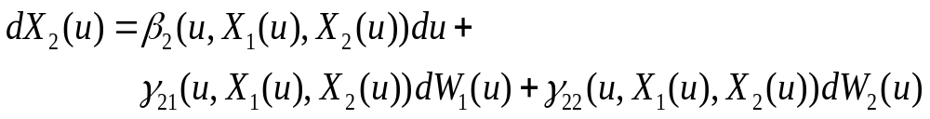
Multidimentional Feynman-Kac Theorem
Consider two stochastic differential equations:
The solution to this pair of stochastic differential equations,starting at X₁(t)=x₁ and X₂(t)=x₂,depends on the specified initial time t and the initial position x₁ and x₂.

Slide 3
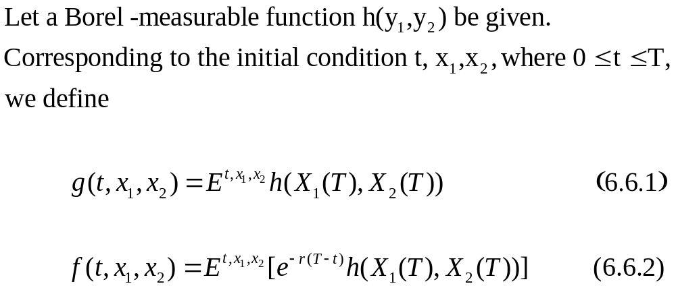
Then

Slide 4
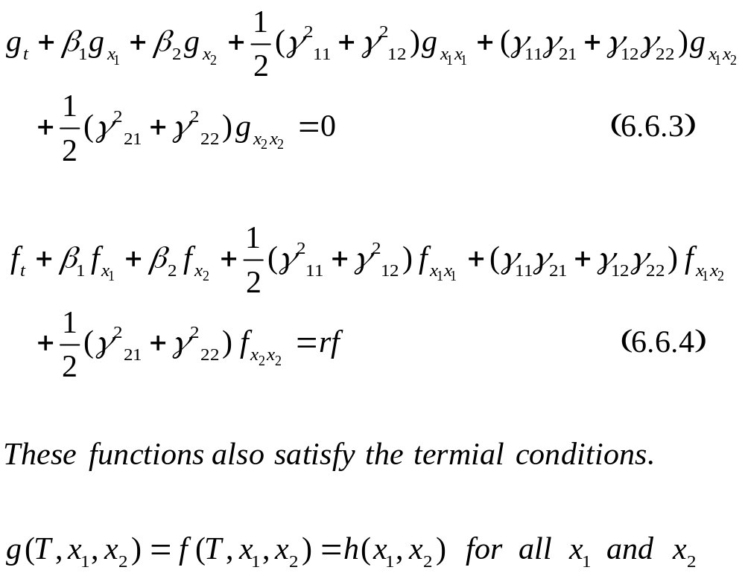

Slide 5
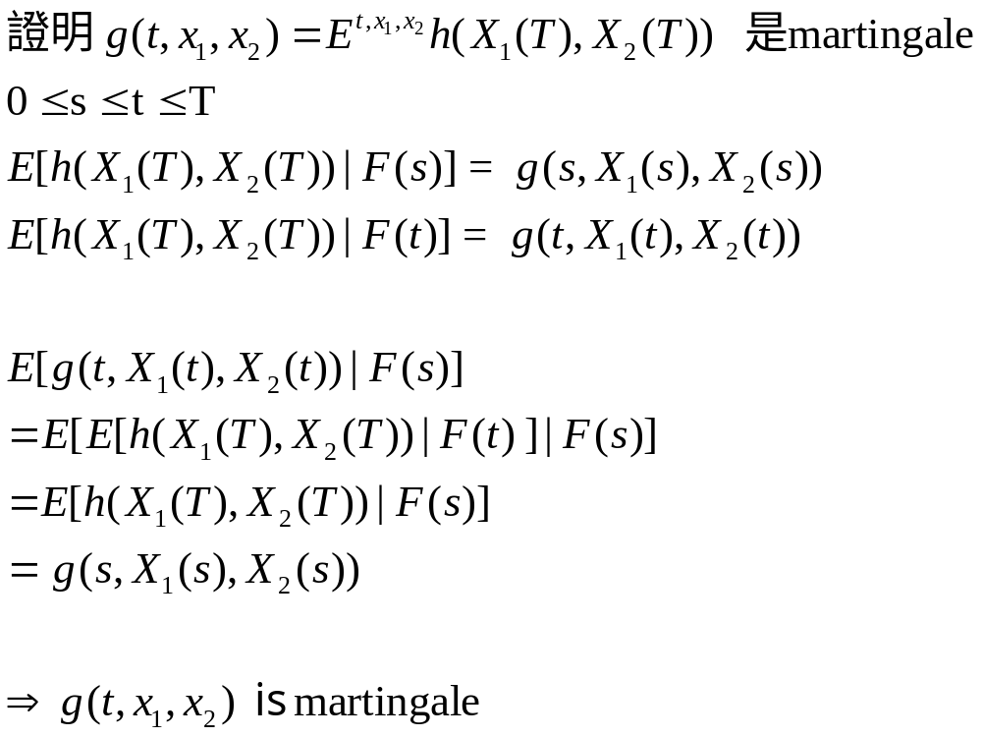
Exercise 6.5

Slide 6
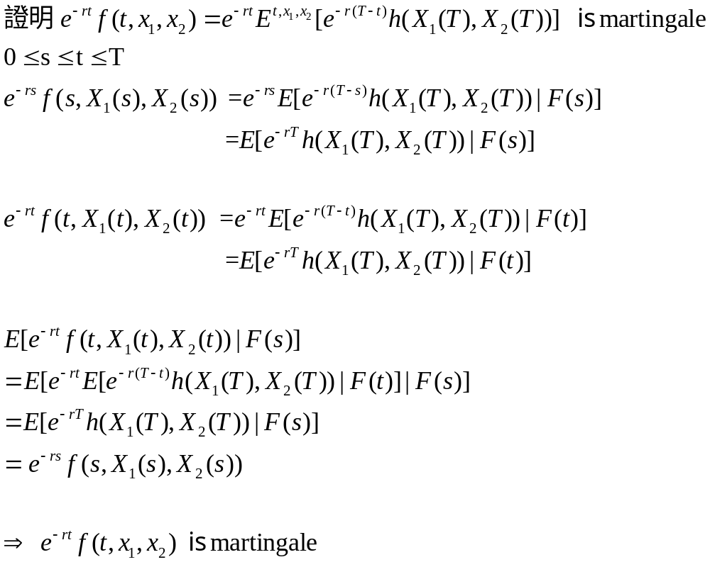
Exercise 6.5(續)

Slide 7
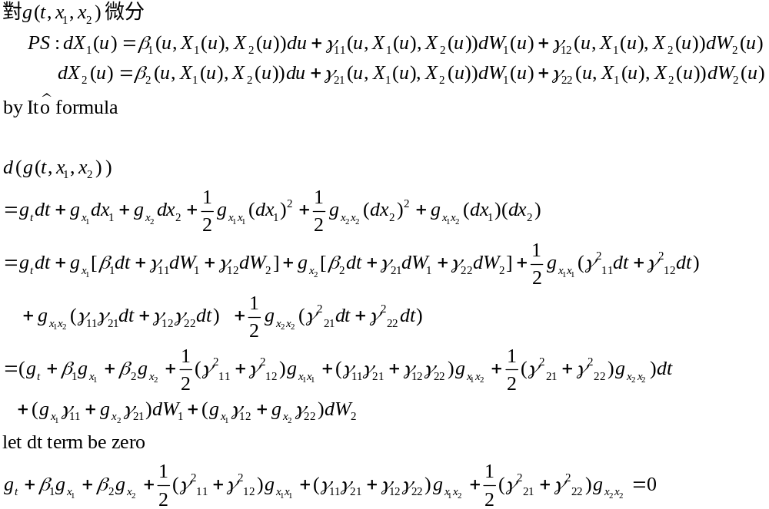
Exercise 6.5(續)

Slide 8
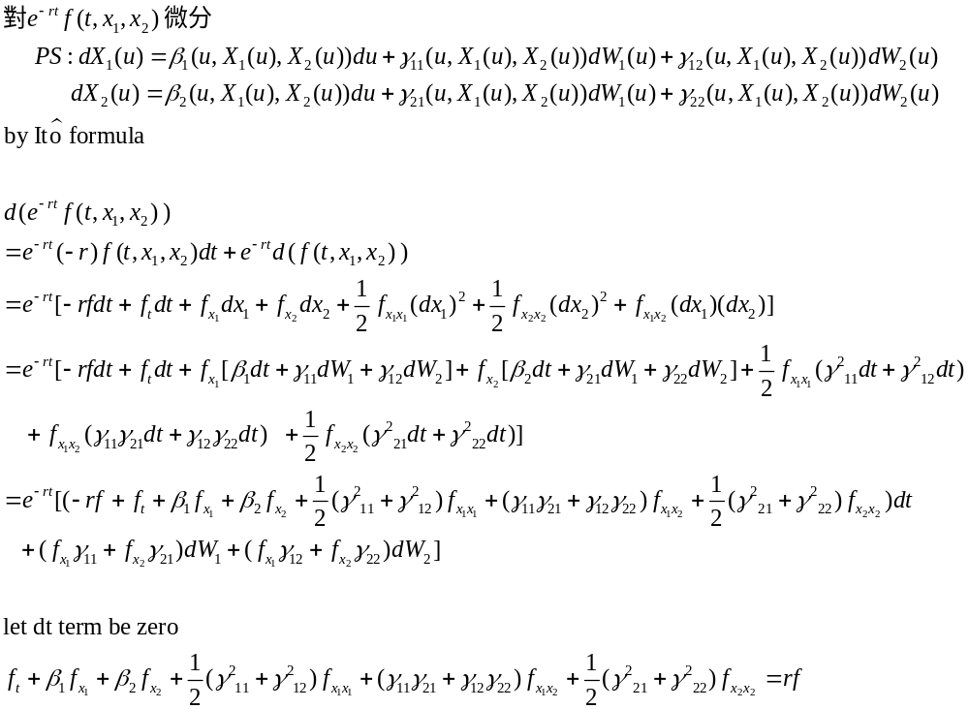
Exercise 6.5(續)

Slide 9
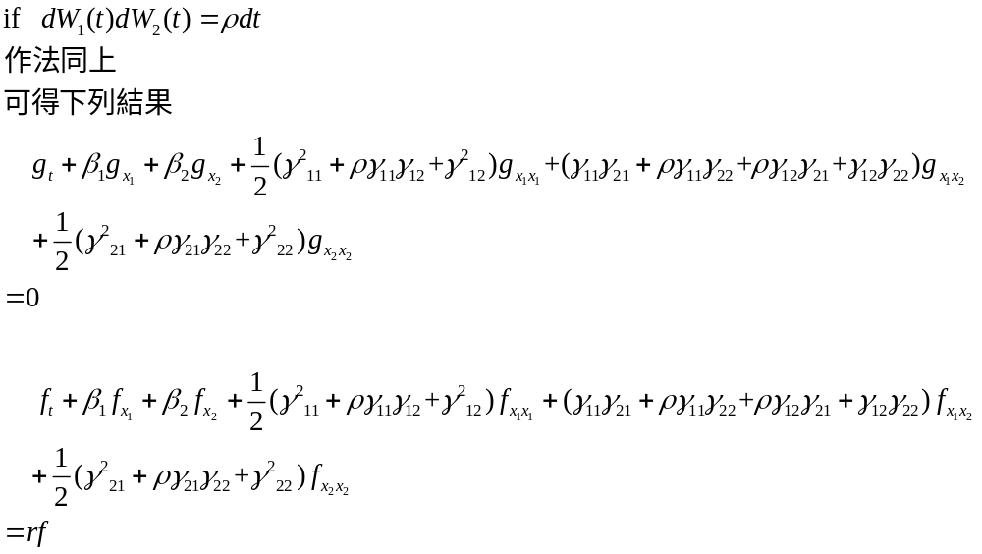
Exercise 6.5(續)

Slide 10
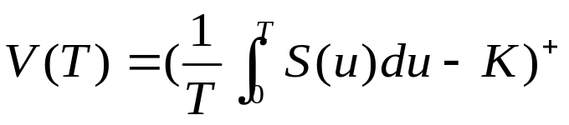


Example 6.6.1 (Asian option)
We show by example how the Discounted Feynman-Kac Theorem can be used to find prices and hedges, even for path-dependent options.
Consider the payoff:
Where S(u) is geometric Brownian motion ,the expiration T is fixed and positive, and K is a positive strike price. In term of the Brownian motion
under the risk-neutral measure we may write the stochastic
differential equation S(u) as

Slide 11
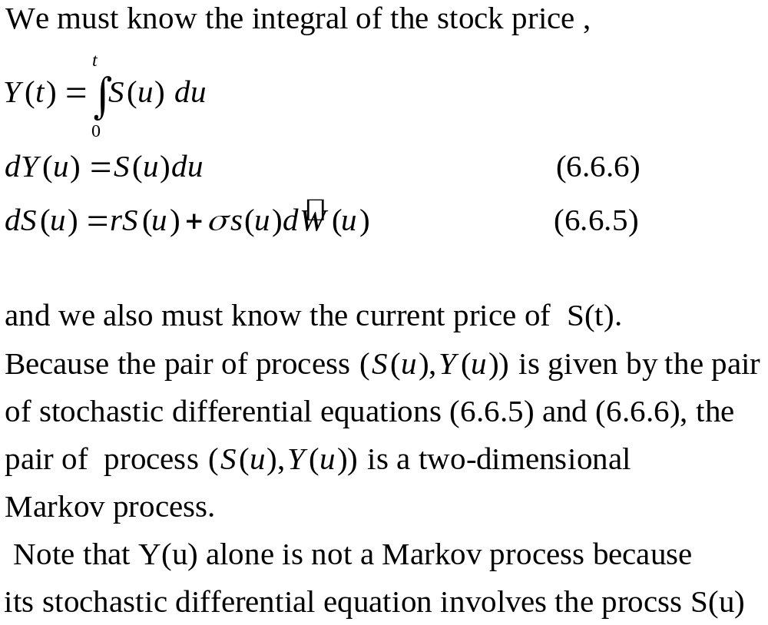
Example 6.6.1 (Asian option)(續)

Slide 12
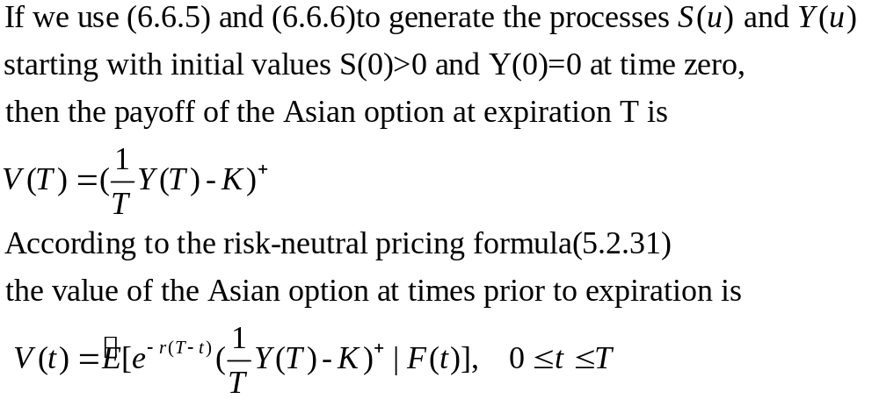
Example 6.6.1 (Asian option)(續)

Slide 13
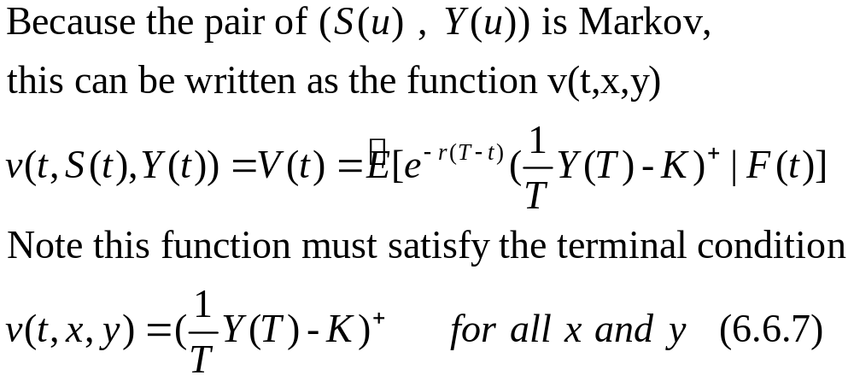
Example 6.6.1 (Asian option)(續)

Slide 14
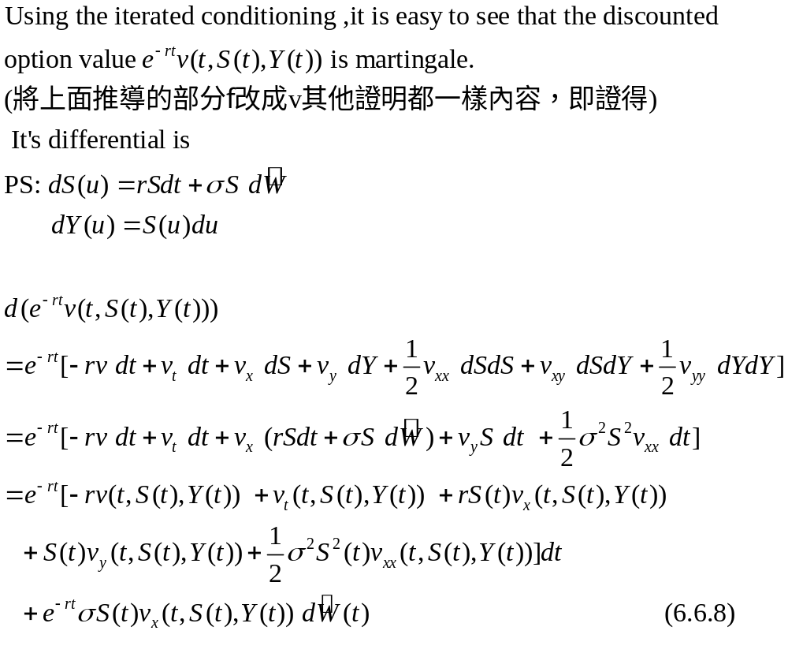
Example 6.6.1 (Asian option)(續)

Slide 15
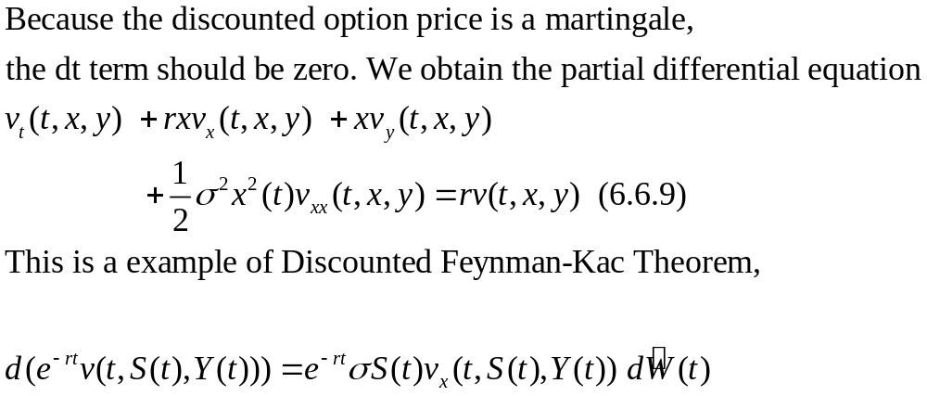
Example 6.6.1 (Asian option)(續)

Slide 16
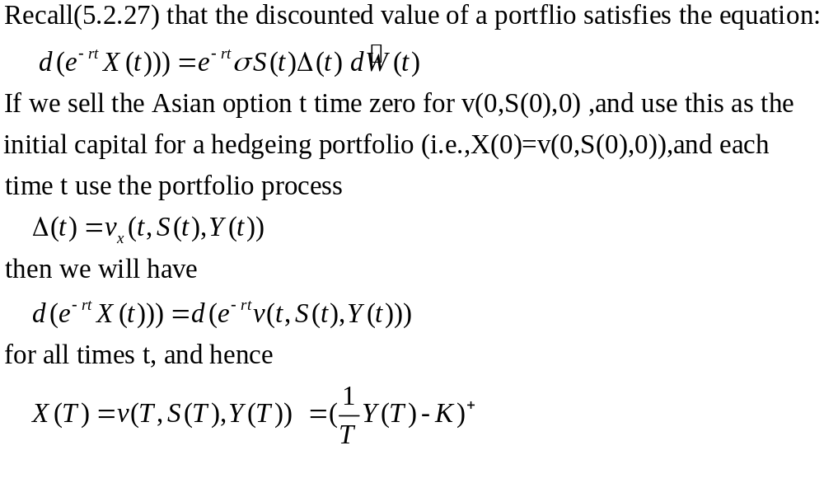
Example 6.6.1 (Asian option)(續)

Slide 17
END

